Slide 1
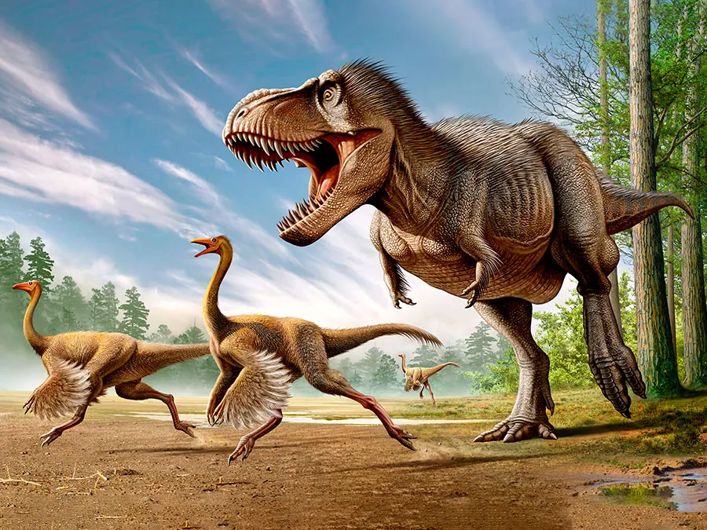
Jurassic Project
Project 3 – Group 5 Members
Jason Butt
Erastus Chirchir
Liu Angela
Brendan Woodward

Slide 2
Jurassic Project Outline
We have chosen our theme to be based on where dinosaur bones/fossils have been found around the world and which Family/Genus these dinosaurs belonged to.
The approach we took was to export data using both an API call and Web Scraping techniques followed using SQLite as our database.
We’ve created a HTML and JS dashboard containing a menu along with multiple charts, that can be updated from the data stored in our database.
We’ve used graphs from the Echart.JS Library in our dashboard.
Our data contains 1000’s of records but we have reduced this by removing non-dinosaur fossils as they wouldn’t fit onto the Heroku server.

Slide 3
Functionally Table
API Call
Web Scraping
Database 1
EAG
LAG
Genus
LAT
LNG
Database 2
Genus
7 Groups
Merged Database
Merged on Genus
Flask API
HTML Website
Heroku Upload

Slide 4
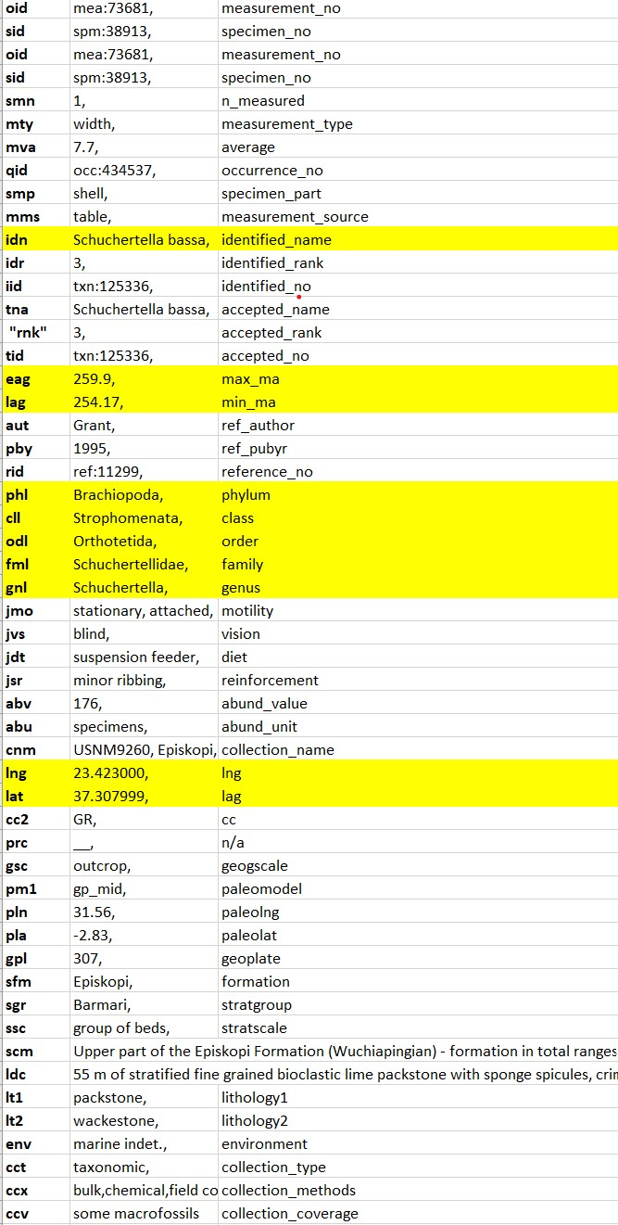
Using an API call we pulled the data of all the locations that fossils have been found across the world. From the pulled data we only kept specific data that either related to the family/group of the fossil, the location the fossil was found and age of the fossil. The location of the fossil is in latitude and longitude which is to be used in our map markers on our HTML page.
API Call

Slide 5
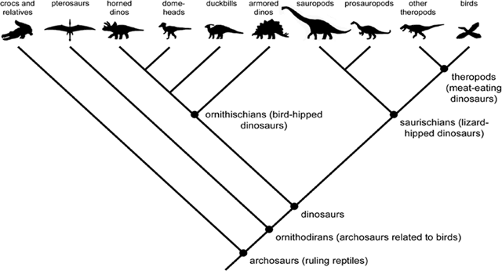
Web scraping was used in order to separate the dinosaur fossils into the 7 major groups, as the original data didn’t separate the fossils into these categories. This was done because the 7 major groups are generally recognisable by both Scientists and even Children. The other categories are far too broad and would make it harder to understand and follow as there are literally 1000’s of different Genera. The 7 major categories are as follows
Web Scraping
Theropods (T-rex etc.)
Sauropods (Big 4-leg herbivore dinosaurs like Brachiosaurus)
Stegosaurs (Plates on their back)
Ankylosaurs (Big club on the tail)
Ornithopods (2 leg herbivores)
Ceratopsians (Triceratops etc.)
Pachycephalosaurs (Big hard plate on the head)

Slide 6
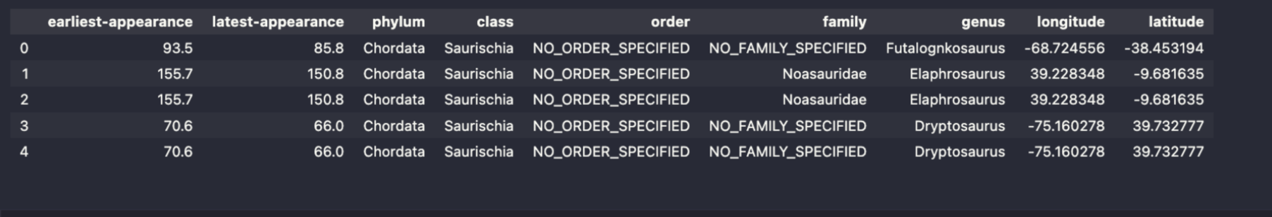
Database 1 & 2
First database: Data from API call
Cleaned the data including dropping Family and Order columns
Fossils aren't able to be classified with certainty due to incompleteness
Second database: Data from Web scraping
Dropped Scientific Name and Species columns
Notes:
Our first database was used to store the data sourced from the API call. SQLite was used for our databases, and the data was cleaned by dropping the family and order columns from the first database, and then the scientific name and species columns from the 2nd database. The Family and Order columns weren’t used as the fossils are not able to be classified with certainty due to the fact that most fossils discovered are incomplete or unable to be related to other fossils.

Slide 7
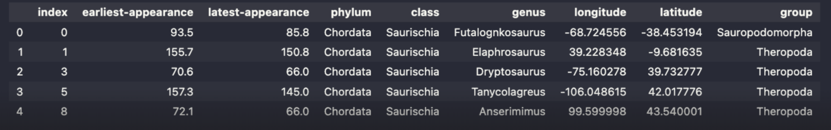
Merged Database
Flask API
We merged the data on the "genus" column to complete our database
We dropped the duplicate rows as part of our cleaning process to make sure that the data would fit onto Heroku
The database was loaded into SQLite
The Flask API was created to call upon data from our database
Notes:
The merged database was joined on the “genus” column, between database 1 and 2. The merged database was finalised by dropping duplicate rows.

Slide 8
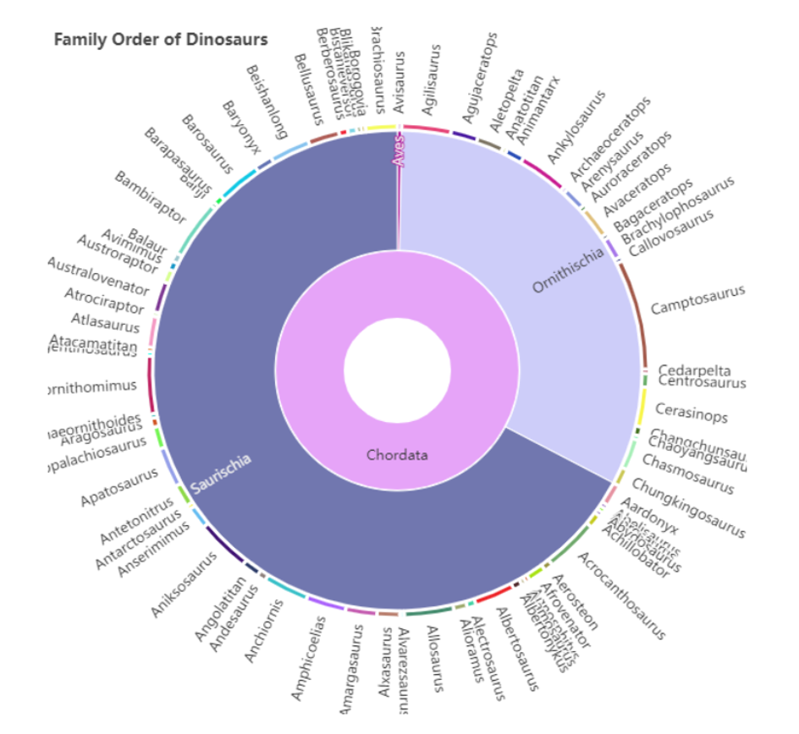
HTML Website
We used Graphs from the Echart.js library like this pie chart
This chart groups the dinosaurs by Genus and shows a distribution of how many fossils of each Genus have been found
We intend to update this chart to group each Genus into the 7 Major groups that were mentioned previously

Slide 9
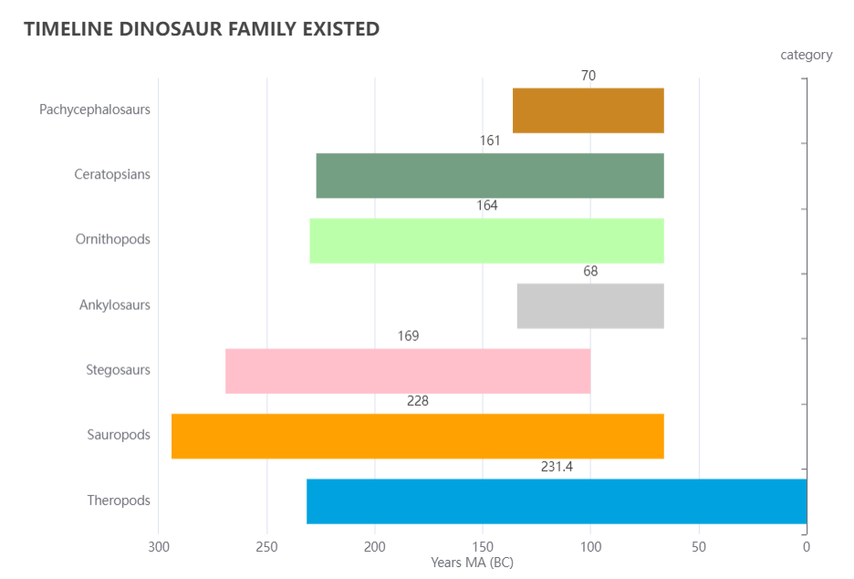
HTML Website
This Horizontal Bar Graph shows the timeline when various dinosaur family existed in millions of years (BC).
The graph shows the sudden mass extinction of three-quarters of the plant and animal species on Earth, approximately 66 million years ago.
Theropods evolved to become modern day birds which is why they are present after the major extinction event.
The Sauropods were the first known family of dinosaur which included the Brontosaurus and Brachiosaurus.

Slide 10
Visualisations
Front end
Back end
HTML
CSS
JS
PYTHON
SQLITE DATABASE
Jquery/Echart
Flask
App.py
Common.py
Ajax
App.py

